Slide 1
Summary of the course

Slide 2
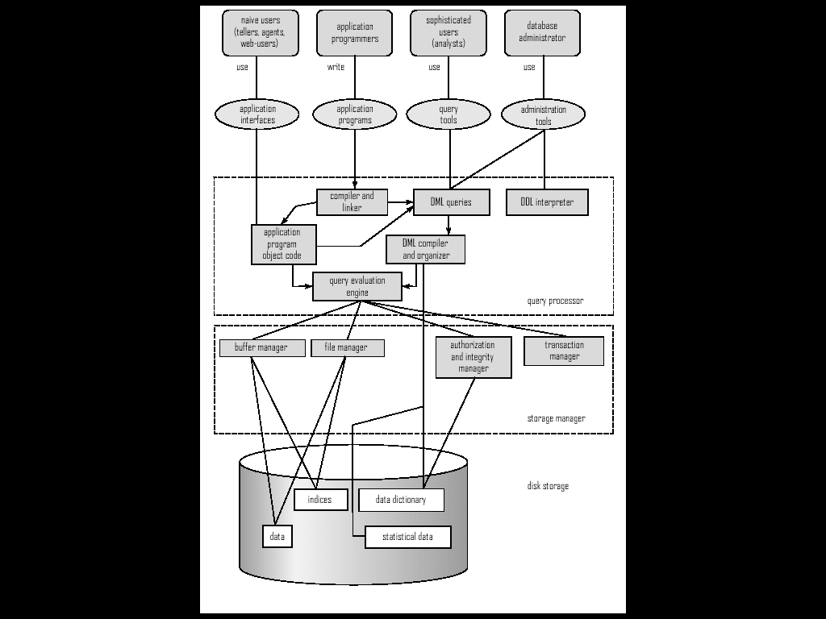
DB system Architecture

Slide 3
Data Model
E-R Model
Relational Data Model
……

Slide 4
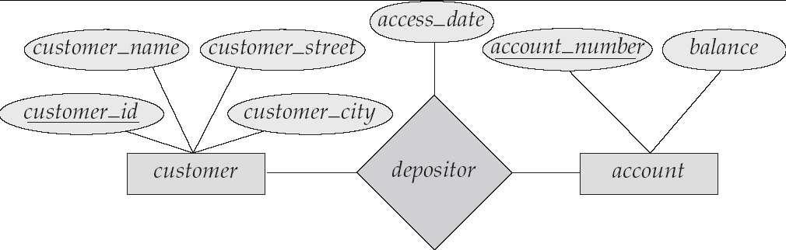
The Entity-Relationship Model
Models an enterprise as a collection of entities and relationships
  Entity: a “thing” or “object” in the enterprise that is distinguishable from other objects
    Described by a set of attributes
  Relationship: an association among several entities
Represented diagrammatically by an entity-relationship diagram:

Slide 5
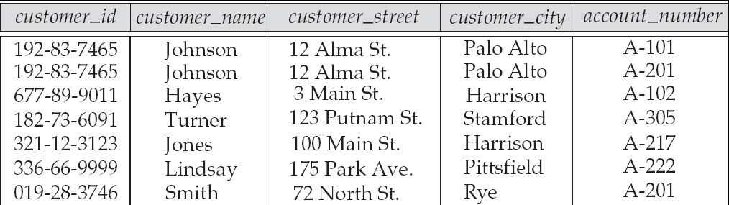
Relational Model
Attributes
Example of tabular data in the relational model

Slide 6
ER Diagram to Relation Schema
Entity
customer(customer_id, customer_name, customer_city, customer_address);
Relationship sets (1:m , m:n, 1:1)
depositor(customer_id, account_number, access_date)
Entity
account(account_number, balance)

Slide 7
Query Languages
Language in which user requests information from the database.
Categories of languages
  Procedural
  Non-procedural, or declarative
“Pure” languages:
  Relational algebra
  Tuple relational calculus
  Domain relational calculus
Pure languages form underlying basis of query languages that people use.

Slide 8
SQL
SQL: widely used non-procedural language
  Example: Find the name of the customer with customer-id 192-83-7465
  select customer.customer_name
  from customer
  where customer.customer_id = ‘192-83-7465’
  Example: Find the balances of all accounts held by the customer with customer-id 192-83-7465
  select account.balance
  from depositor, account
  where depositor.customer_id = ‘192-83-7465’ and
  depositor.account_number = account.account_number
Application programs generally access databases through one of
  Language extensions to allow embedded SQL
  Application program interface (e.g., ODBC/JDBC) which allow SQL queries to be sent to a database
More details in Chapter 3.
Notes:
/Im’bed/

Slide 9
Relational Algebra
Procedural language
Six basic operators
  select: σ
  project: ∏
  union: ∪
  set difference: –
  Cartesian product: x
  rename: ρ
The operators take one or two relations as inputs and produce a new relation as a result.
More details in Chapter 2.

Slide 10
Conversion between SQL and RA
  ∏customer_name (σbranch_name = “Perryridge” (
  σborrower.loan_number = loan.loan_number (borrower x loan)))
Select customer_name
From borrower, loan
Where loan.branch_name= “Perryridge” and borrower.loan_number = loan.loan_number

Slide 11
Privileges in SQL
select: allows read access to relation,or the ability to query using the view
  Example: grant users U₁, U₂, and U₃ select authorization on the branch relation:
grant select on branch to U₁, U₂, U₃ [with grant option]
  revoke select on branch from U₁, U₂, U₃
insert: the ability to insert tuples
update: the ability to update using the SQL update statement
delete: the ability to delete tuples.
all privileges: used as a short form for all the allowable privileges
more in Chapter 4 and 8.

Slide 12
Boyce-Codd Normal Form
A relation schema R is in BCNF with respect to a set F of functional dependencies if for all functional dependencies in F⁺ of the form
α → β
where α ⊆ R and β ⊆ R, at least one of the following holds:
α  → β is trivial (i.e., β ⊆ α)
α is a superkey for R
Example schema not in BCNF:
bor_loan = ( customer_id, loan_number, amount )
because loan_number → amount holds on bor_loan
but loan_number is not a superkey

Slide 13
Third Normal Form
A relation schema R is in third normal form (3NF) if for all:
α → β in F⁺
at least one of the following holds:
  α → β is trivial (i.e., β ⊆ α)
  α is a superkey for R
  Each attribute A in β – α is contained in a candidate key for R.
  (NOTE: each attribute may be in a different candidate key)
If a relation is in BCNF it is in 3NF (since in BCNF one of the first two conditions above must hold).
Third condition is a minimal relaxation of BCNF to ensure dependency preservation .
Notes:
/preze’vei../

Slide 14
Closure of Attribute Sets
Given a set of attributes α, define the closure of α under F (denoted by α⁺) as the set of attributes that are functionally determined by α under F
Algorithm to compute α⁺, the closure of α under F
result := α;
while (changes to result) do
for each β → γ in F do
begin
if β ⊆ result then result := result ∪ γ
end
Notes:
Pause here

Slide 15
Example of Attribute Set Closure
R = (A, B, C, G, H, I)
F = {A → B
A → C
CG → H
CG → I
B → H}
(AG)⁺
  result = AG
  result = ABG ( A → B)
  result=ABCG (A → C)
  result = ABCGH (CG → H and CG ⊆ AGBC)
  result = ABCGHI (CG → I and CG ⊆ AGBCH)
Is AG a candidate key?
  Is AG a super key?
    Does AG → R? == Is (AG)⁺ ⊇ R
  Is any subset of AG a superkey?
    Does A → R? == Is (A)⁺ ⊇ R
    Does G → R? == Is (G)⁺ ⊇ R
Notes:
1. Yes
2. No.

Slide 16
Uses of Attribute Closure
There are several uses of the attribute closure algorithm:
Testing for superkey:
  To test if α is a superkey, we compute α^{+,} and check if α⁺ contains all attributes of R.
Testing functional dependencies
  To check if a functional dependency α → β holds (or, in other words, is in F⁺), just check if β ⊆ α⁺.
  That is, we compute α⁺ by using attribute closure, and then check if it contains β.
  Is a simple and cheap test, and very useful
Computing closure of F
  For each γ ⊆ R, we find the closure γ⁺, and for each S ⊆ γ⁺, we output a functional dependency γ → S.
Notes:
β→γ

Slide 17
3NF Decomposition Algorithm
Let F_{c} be a canonical cover for F;
i := 0;
for each functional dependency α → β in F_{c} do
if none of the schemas R_{j}, 1 ≤ j ≤ i contains α β
then begin
i := i + 1;
R_{i} := α β
end
if none of the schemas R_{j}, 1 ≤ j ≤ i contains a candidate key for R
then begin
i := i + 1;
R_{i} := any candidate key for R;
end
return (R₁, R₂, ..., R_{i})
Notes:
The second if-then-end is to establish a schema containing candidate key if the first if-then-else does not.

Slide 18
BCNF Decomposition Algorithm
result := {R };
done := false;
compute F ⁺;
while (not done) do
if (there is a schema R_{i} in result that is not in BCNF)
then begin
let α  → β be a nontrivial functional dependency that holds on R_{i}
such that α  → R_{i} is not in F ⁺,
and α ∩ β = ∅;
result := (result – R_{i} ) ∪ (R_{i} – β) ∪ (α, β );
end
else done := true;
Note: each R_{i} is in BCNF, and decomposition is lossless-join.
Notes:
α  → R_{i} is not in F ⁺ means α  is not a superkey.
First time, Rj is R.
This is the completed algorithm . The previous example (just the last two parts of formula result) also obey this algorithm.

Slide 19
Decomposing a Schema into BCNF
Suppose we have a schema R and a non-trivial dependency α →β causes a violation of BCNF.
We decompose R into:
  (α U β )
  ( R - ( β - α ) )
In our example, bor_loan = ( customer_id, loan_number, amount )
  α = loan_number
  β = amount
  and bor_loan is replaced by
  (α U β ) = ( loan_number, amount )
  ( R - ( β - α ) ) = ( customer_id, loan_number )
Notes:
β - α=amount;

Slide 20
补充材料-无损连接检验
输入: 关系模式R(A1,A2,……An),它的函数依赖集F, 以及分解p={R1,R2,……Rk).
输出: 确定p是否具有无损连接性.
方法:
(1) 构造一个k行,n列的表,第i行对应对关系模式Ri, 第j列对应于属性Aj。若Aj∈Ri, 则在第i行 j 列上放符号aj, 否则放bij.
(2) 逐个检查F中的每一个函数依赖X→Y，在X对应的列中找相同的行，然后将这些行中Y对应的属性值改为相同符号，若其中有aj;则将bij改为aj;若其中无ai,则改为bij.
(3) 反复执行第（2）步，如果发现某一行变成a1,a2,……an,则分解p具有无损连接性。

Slide 21
p1={AB,BC}; F={A→B, C→B},
(1)
Construct the checking table.
(2)
A→B; no changes
C→B. no changes
(3) lossy。
Ri | A | B | C
AB | a1 | a2 | b13
BC | b21 | a2 | a3

Slide 22
Measures of Query Cost
Cost is generally measured as total elapsed time for answering query
  Many factors contribute to time cost
    disk accesses, CPU, or even network communication
For simplicity we just use the number of block transfers from disk and the number of seeks as the cost measures
  t_{T} – time to transfer one block
  t_{S} – time for one seek
  Cost for b block transfers plus S seeks
  b * t_{T} + S * t_{S}

Slide 23
Selection Operation
A1-A7
Join Operation
  Nested-loop join
  Block nested-loop join
  Indexed nested-loop join
  Merge-join
  Hash-join

Slide 24
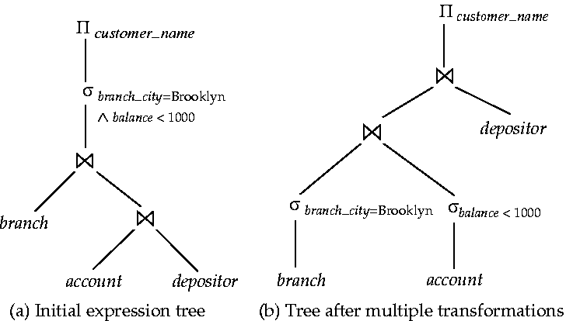
Equivalence rule
Rule1-12.

Slide 25
Heuristic Optimization
Cost-based optimization is expensive, even with dynamic programming.
Systems may use heuristics to reduce the number of choices that must be made in a cost-based fashion.
Heuristic optimization transforms the query-tree by using a set of rules that typically (but not in all cases) improve execution performance:
  Perform selection early (reduces the number of tuples)
  Perform projection early (reduces the number of attributes)
  Perform most restrictive selection and join operations before other similar operations.
Some systems use only heuristics, others combine heuristics with partial cost-based optimization.

Slide 26
ACID Properties
A transaction is a unit of program execution that accesses and possibly updates various data items.To preserve the integrity of data the database system must ensure:
Atomicity. Either all operations of the transaction are properly reflected in the database or none are.
Consistency. Execution of a transaction in isolation preserves the consistency of the database.
Isolation. Although multiple transactions may execute concurrently, each transaction must be unaware of other concurrently executing transactions. Intermediate transaction results must be hidden from other concurrently executed transactions.
  That is, for every pair of transactions T_{i} and T_{j}, it appears to T_{i} that either T_{j}, finished execution before T_{i} started, or T_{j} started execution after T_{i} finished.
Durability. After a transaction completes successfully, the changes it has made to the database persist, even if there are system failures.

Slide 27

Transaction State

Slide 28
Conflict Serializability
If a schedule S can be transformed into a schedule S´ by a series of swaps of non-conflicting instructions, we say that S and S´ are conflict equivalent.
We say that a schedule S is conflict serializable if it is conflict equivalent to a serial schedule

Slide 29
Log-Based Recovery
A log is kept on stable storage.
  The log is a sequence of log records, and maintains a record of update activities on the database.
When transaction T_{i} starts, it registers itself by writing a
<T_{i} start>log record
Before T_{i} executes write(X), a log record <T_{i}, X, V₁, V₂> is written, where V₁ is the value of X before the write, and V₂ is the value to be written to X.
  Log record notes that T_{i} has performed a write on data item X_{j} X_{j} had value V₁ before the write, and will have value V₂ after the write.
When T_{i} finishes it last statement, the log record <T_{i} commit> is written.
We assume for now that log records are written directly to stable storage (that is, they are not buffered)
Two approaches using logs
  Deferred database modification
  Immediate database modification

Slide 30
The End

